Slide 1

VITAL PARAMETER MEASUREMENT USING A SMARTPHONE APPLICATION
TEAM- ALPHA BETA GAMMA

Slide 2
AIMS OF OUR PROJECT
Heart rate

Slide 3

EXISTING METHODOLOGIES
Electrocardiography
Photoplethysmography
Wrist-worn devices
On-ear devices

Slide 4
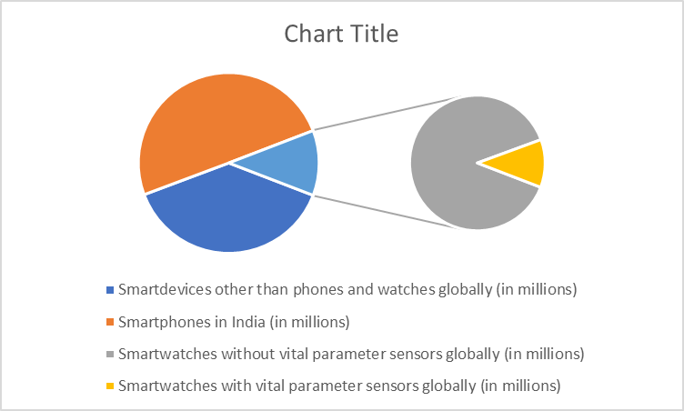
INDIA’S TRENDS IN SMARTDEVICES USAGE

Slide 5
WHAT THE APP DOES
Recording video using front camera
Processing vital parameters from the video
Displaying clinical inferences and suggestions in the smartphone app

Slide 6
VIOLA JONES ALGORITHM-FACE DETECTION
Frame
Adaboost Machine Learning
Cascade Classifier
Face / Not Face
Haar Feature
Integral Image
Frame processing

Slide 7
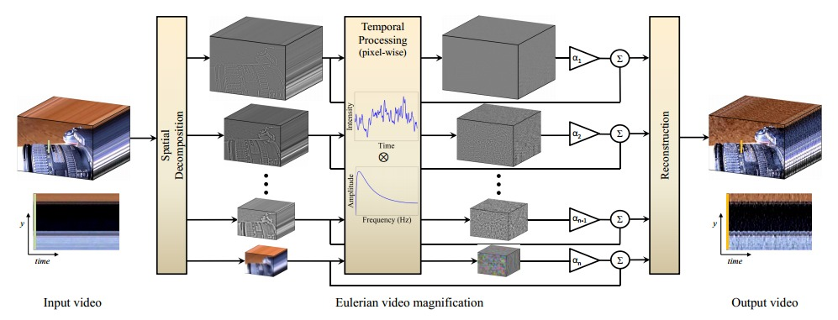
EULERIAN VIDEO MAGNIFICATION

Slide 8
WORKFLOW
Facial detection using Viola-Jones algorithm
Heart rate prediction using Eulerian Video Magnification (EVM)
Display of heart rate in the smartphone application

Slide 9
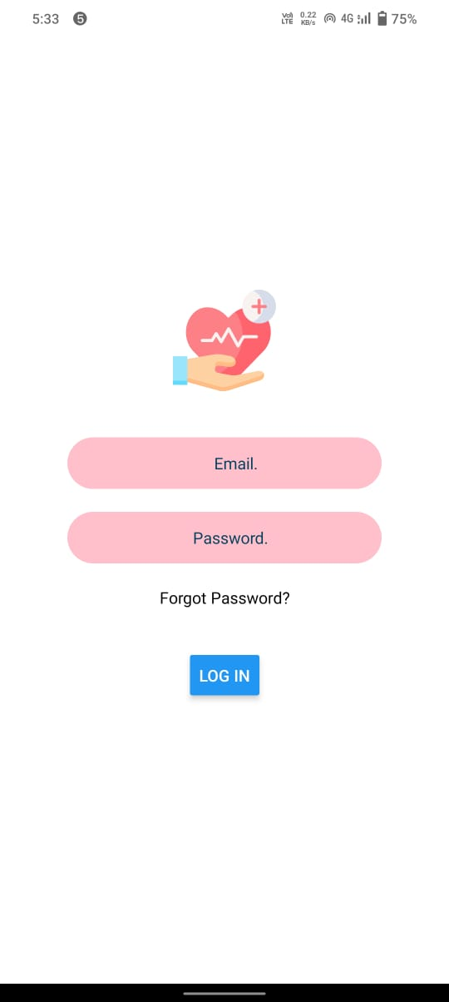
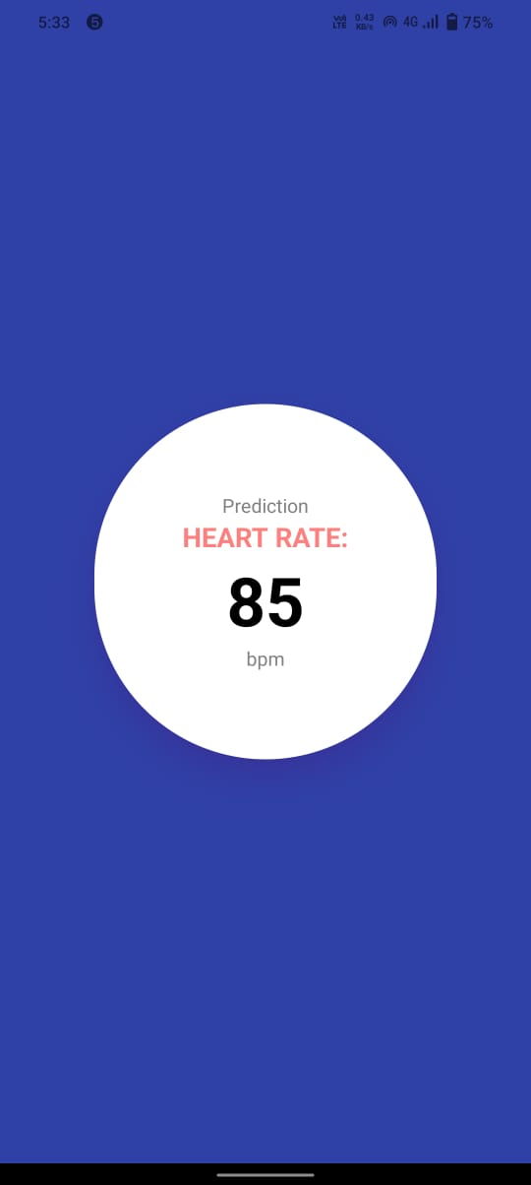
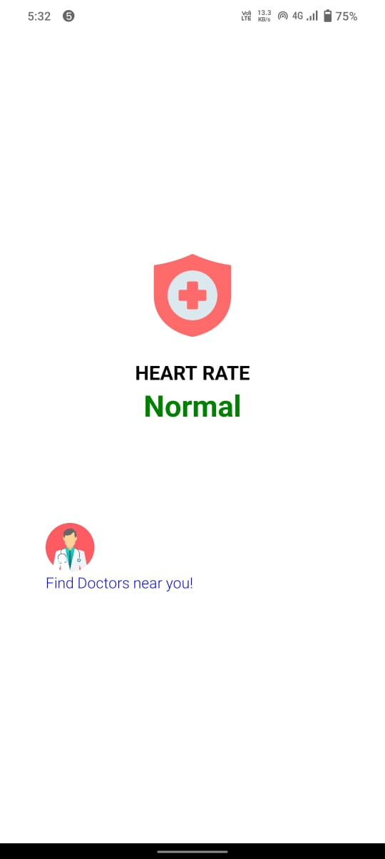
UI/UX OUTPUT

Slide 10

Thank You!

